Slide 1


Employee Turnover
Insights on why Employee leave?

Slide 2

Use Case:
XYZ Corporation is a sportswear company. They are having difficulty controlling their employee turnover rates. It is important that XYZ understand first, who is likely to be leave the company and why, and second, activities they can engage in to start decreasing the volume of employees that leave. It is estimated that each employee that quits represents a cost of 300% of their annual salary.
They have collected the data on their employees that they have found so far and would like to use this dataset to predict which employees are at risk of leaving and why.

Slide 3
How?
Designer
Automate ML
Notebook

Slide 4
Model Features
Current Evaluation Model of Likelihood to Leave
EmployeeLeft – (label)
Hired through SMTP, Marked for PHT Program
Recruiting Location Code,
Salary
Survey, Relative, Attitude toward Environment
Survey, Relative, Attitude toward Peers
Survey, Relative, Peers Average Attitude toward Peers
Survey, Relative, Peers Average Attitude toward Work/Life Balance
University (Category column)

Slide 5
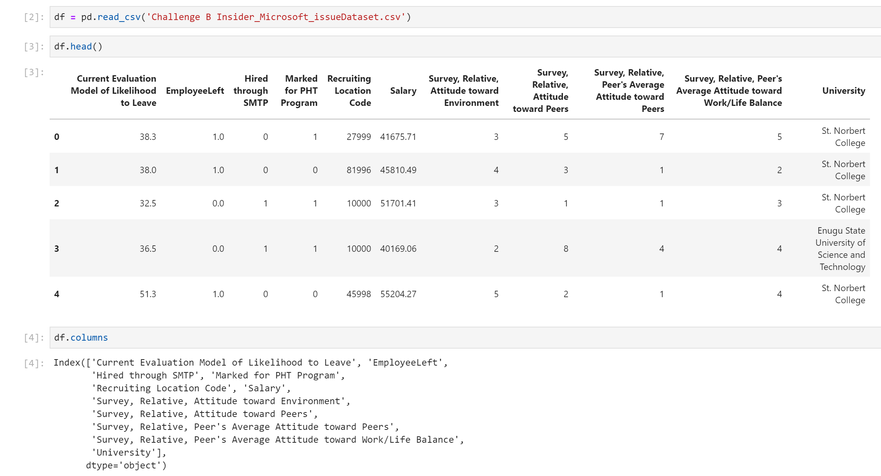

Slide 6
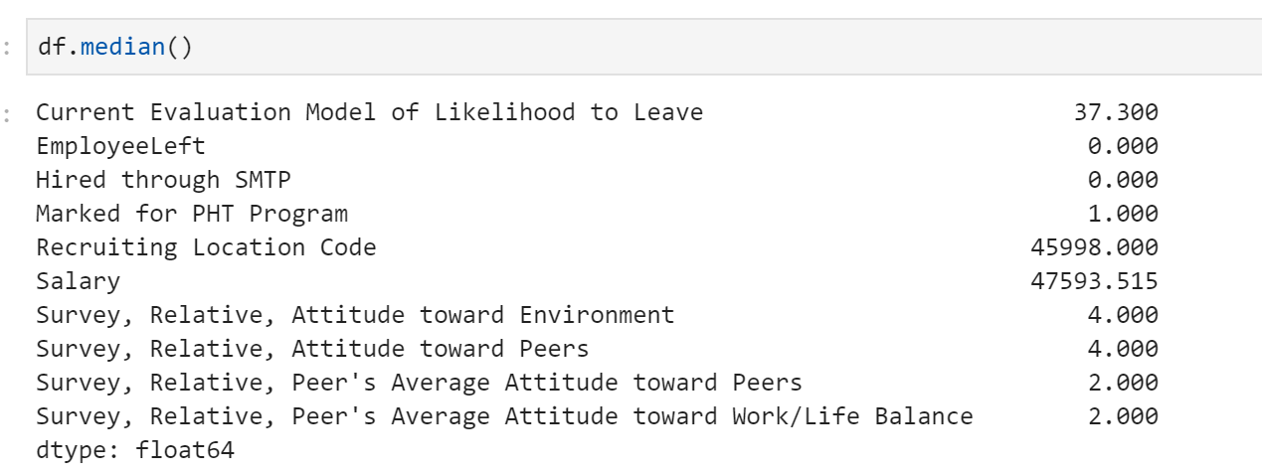
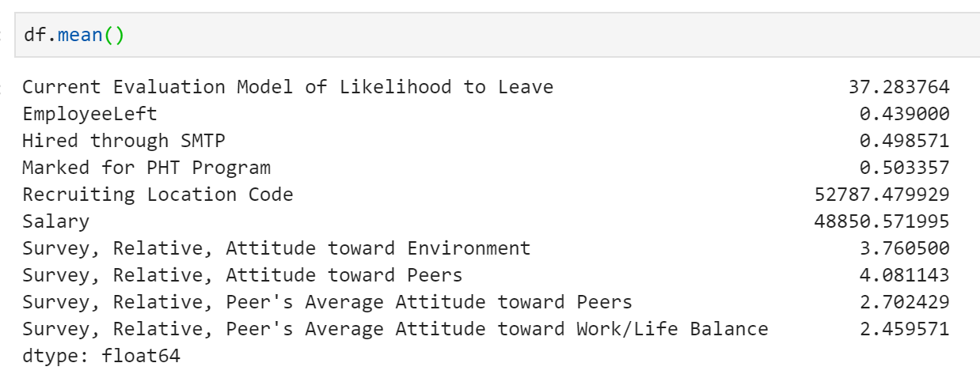
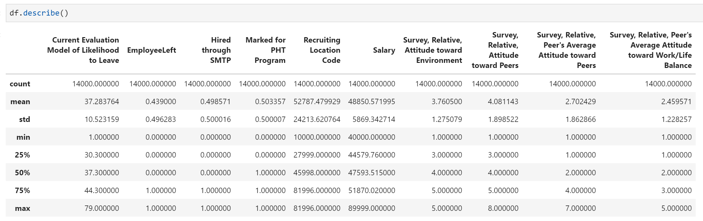

Slide 7
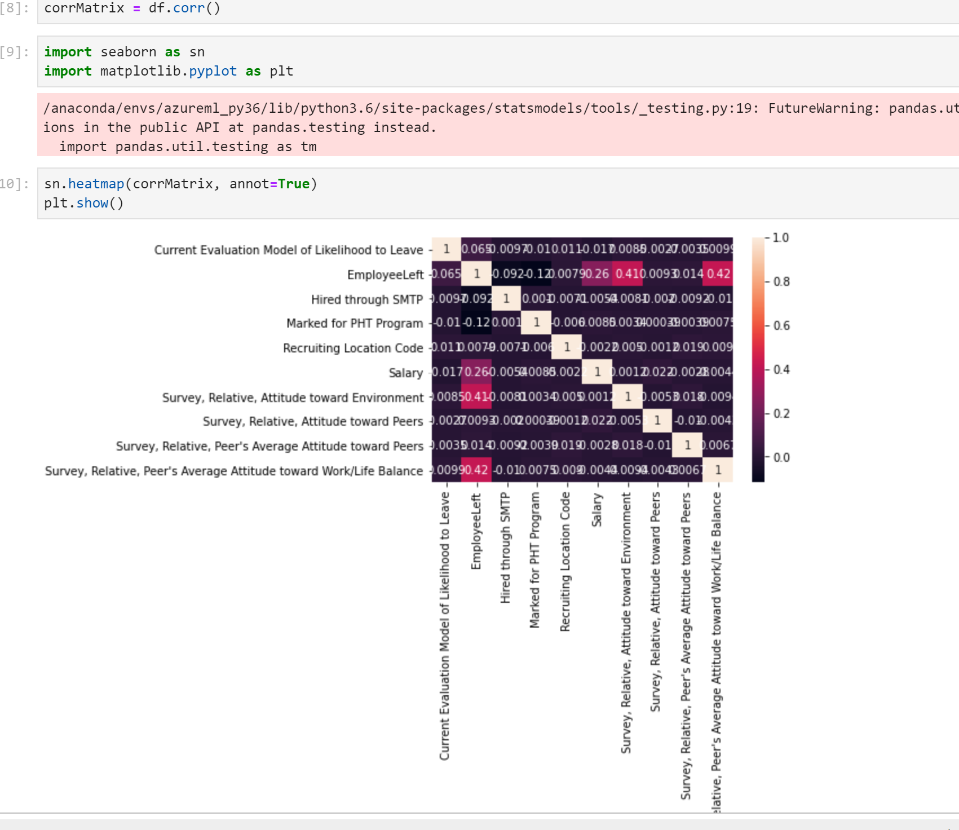
Correlation

Slide 8
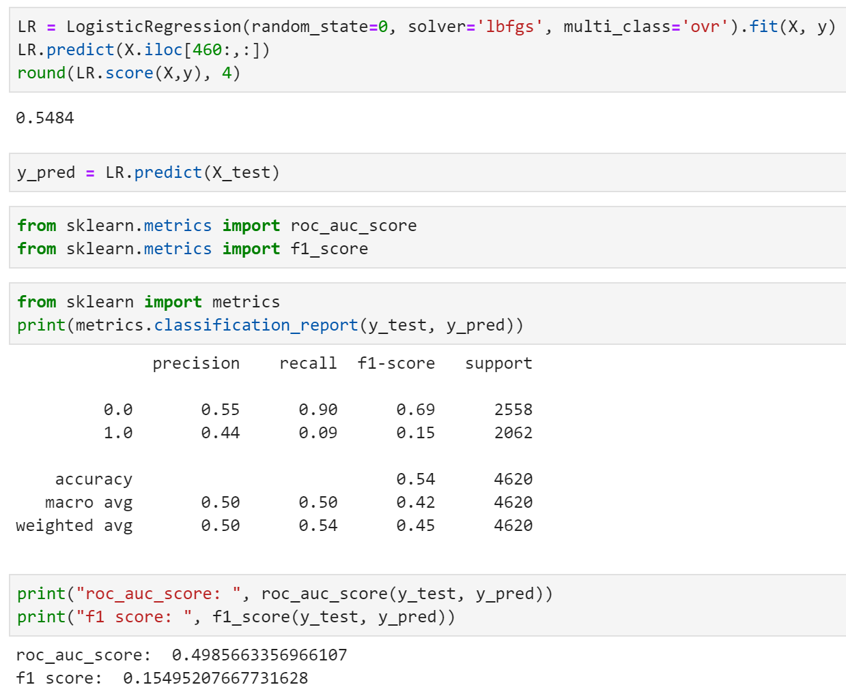
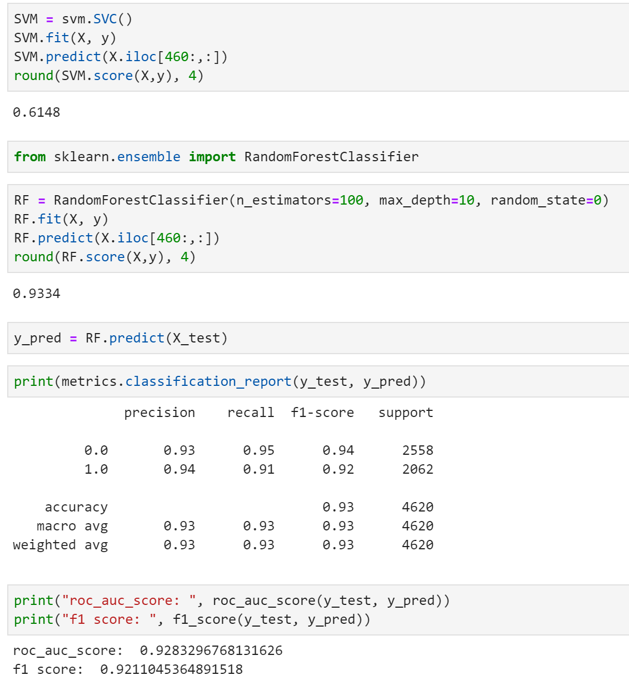
Model Summary

Slide 9
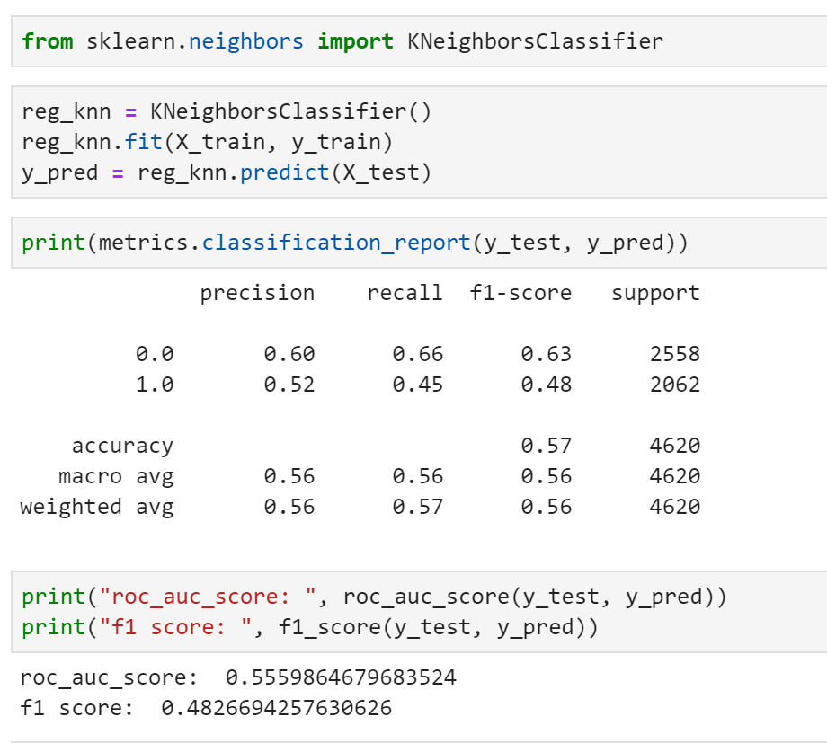
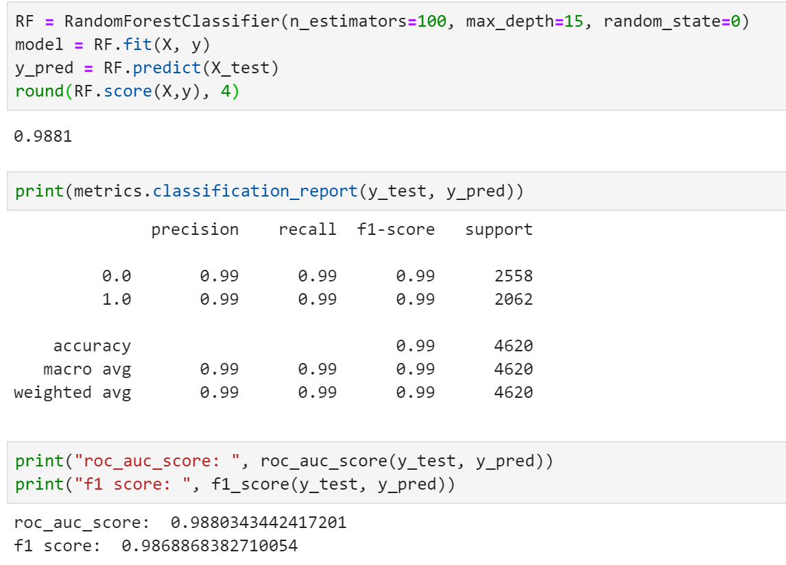
Model Summary

Slide 10
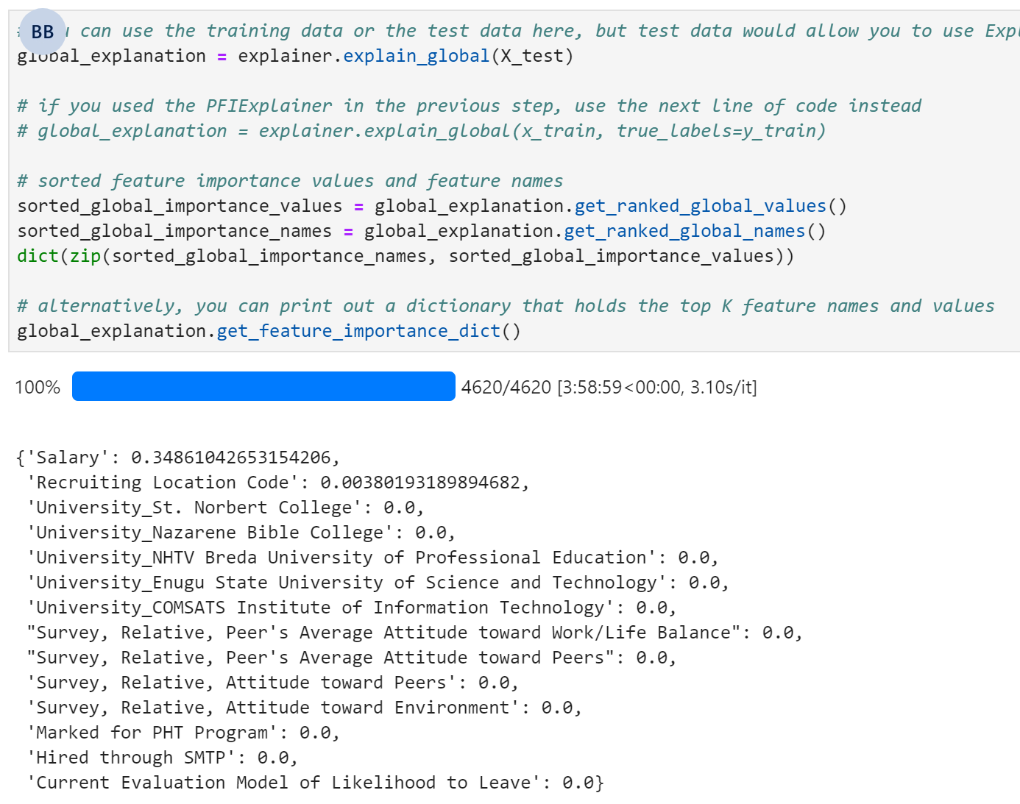
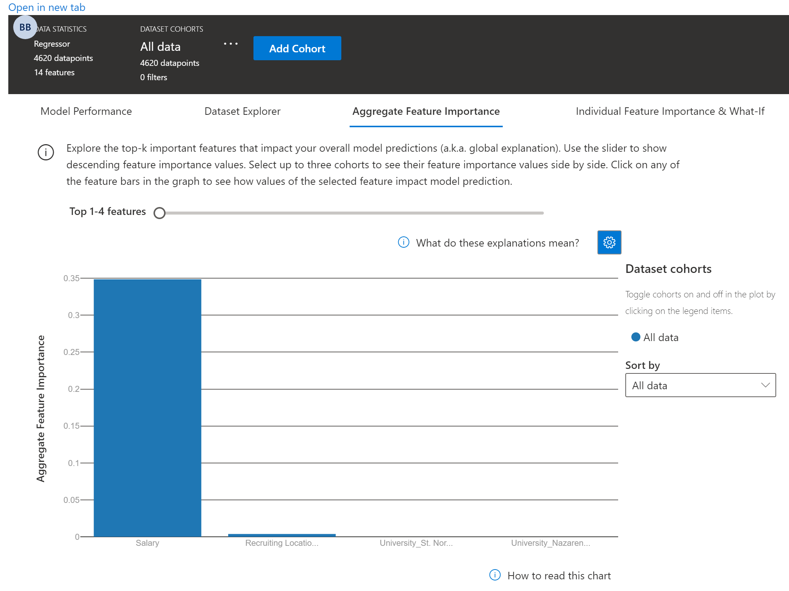
Explainability

Slide 11
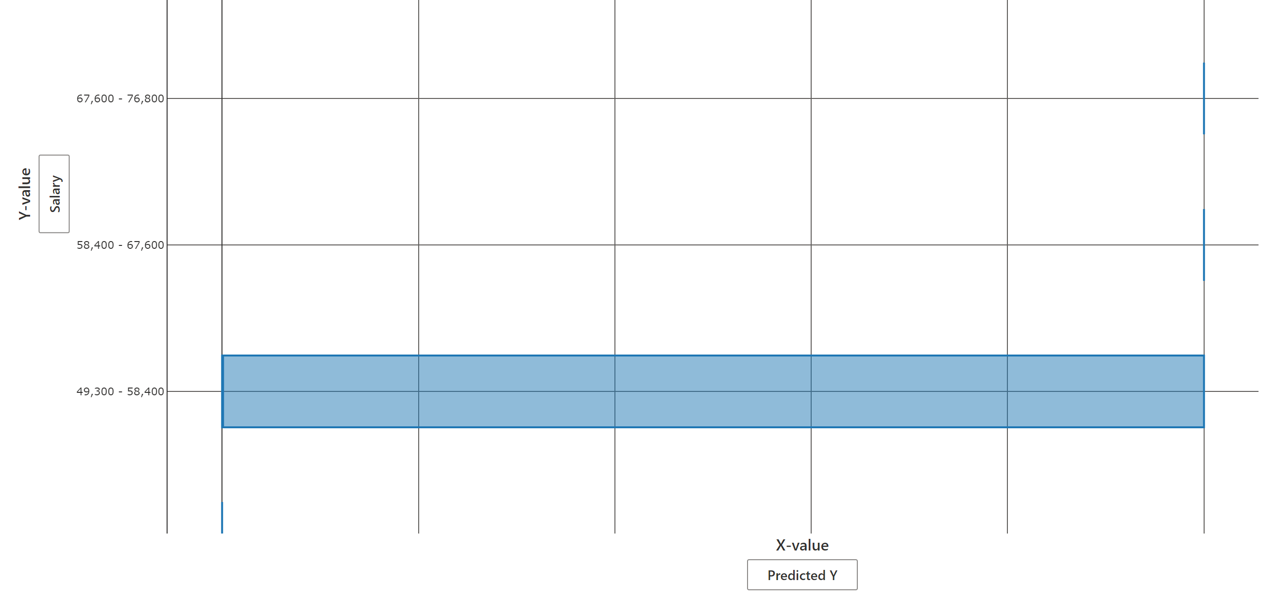
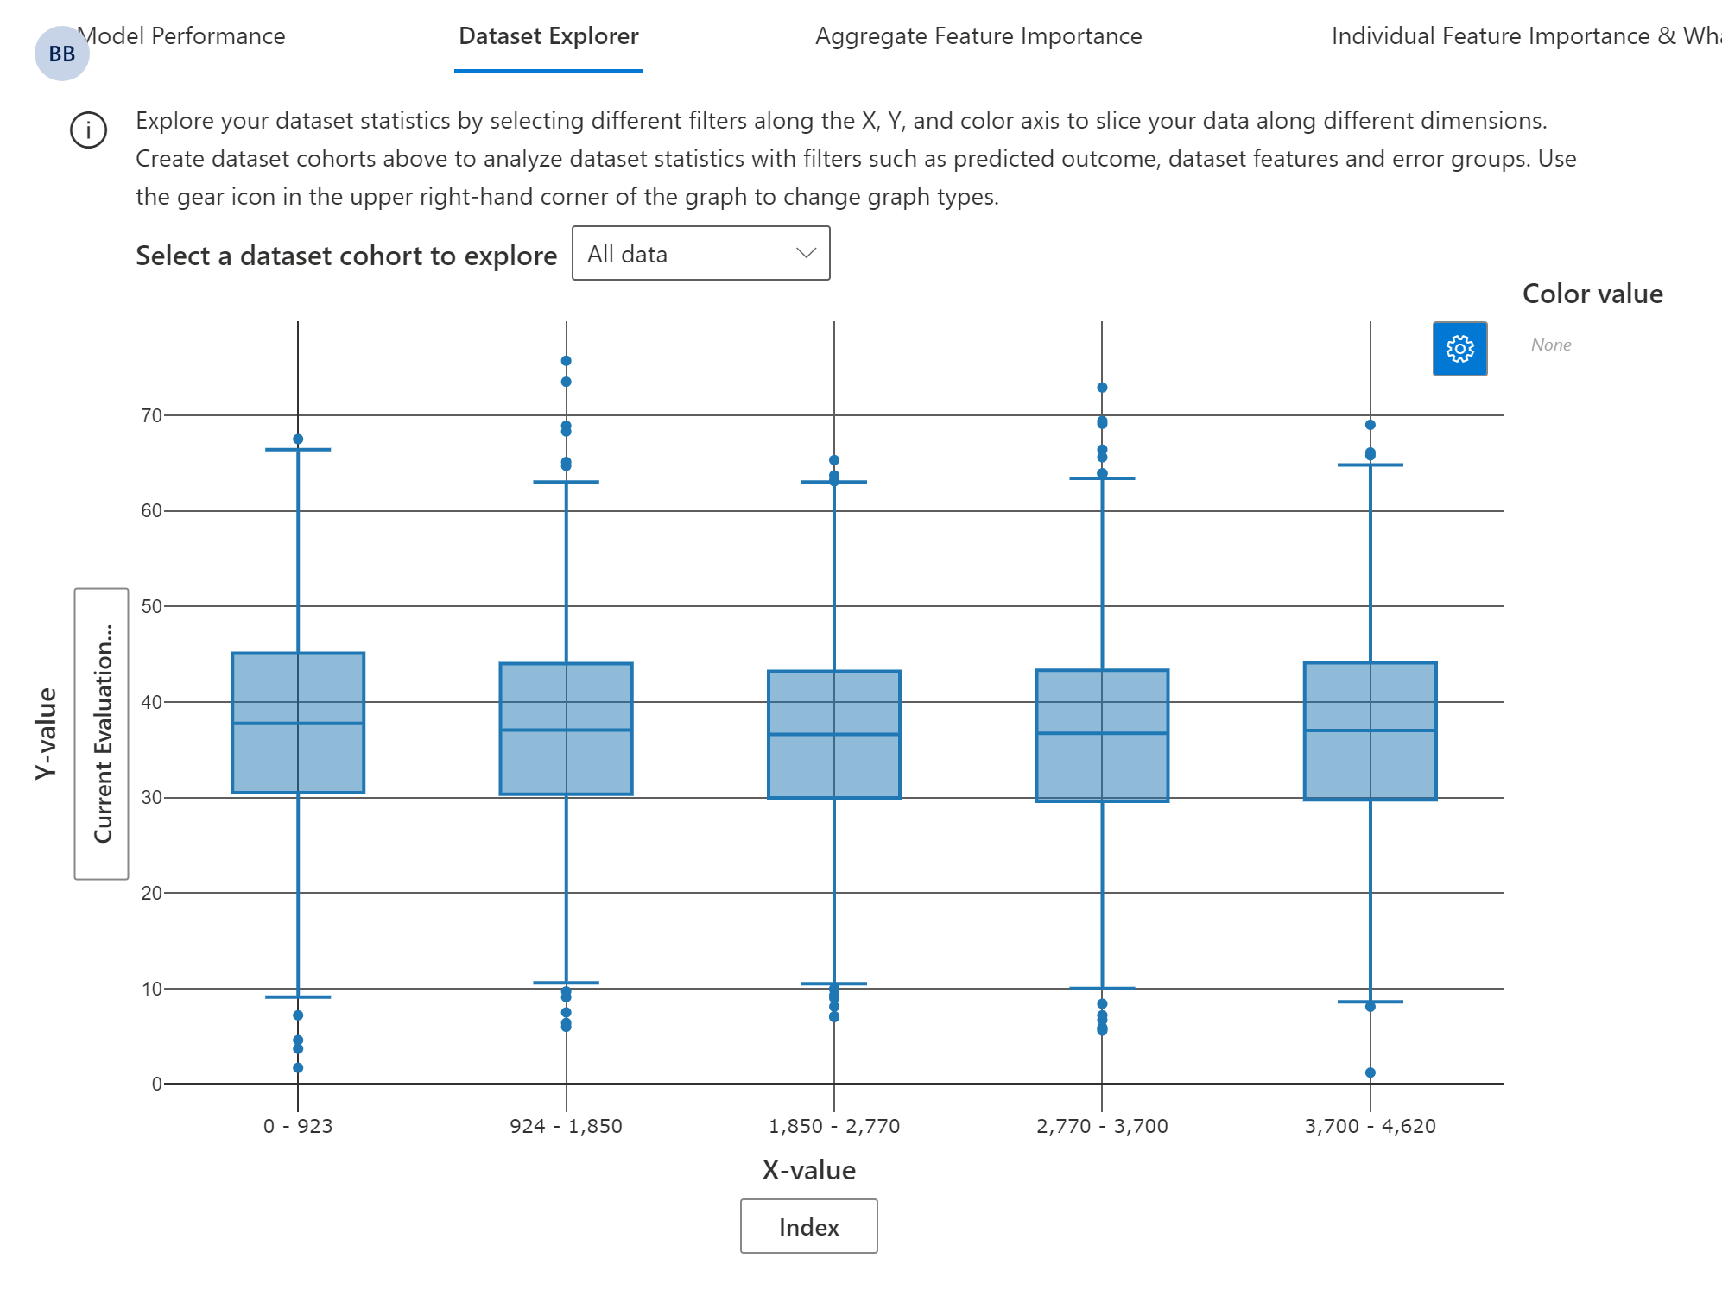
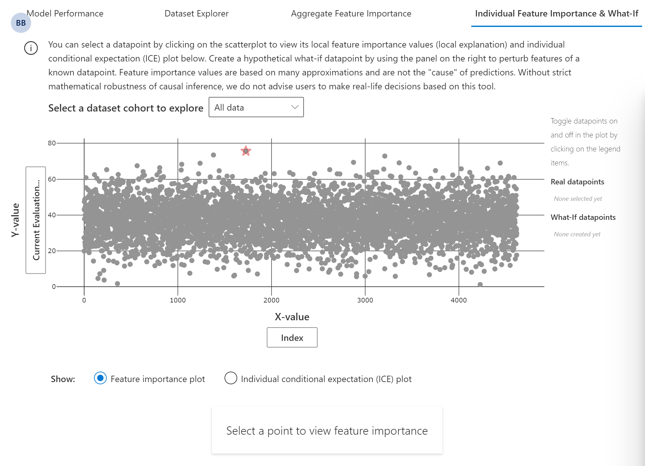
Explainability
This explainer uses SHAP, which is a game theoretic approach to explaining models, where the importance of features sets is measured by "hiding" those features from the model through marginalization.
This dependence plot shows the relationship between the value of a feature to the corresponding importance of the feature across a cohort.

Slide 12
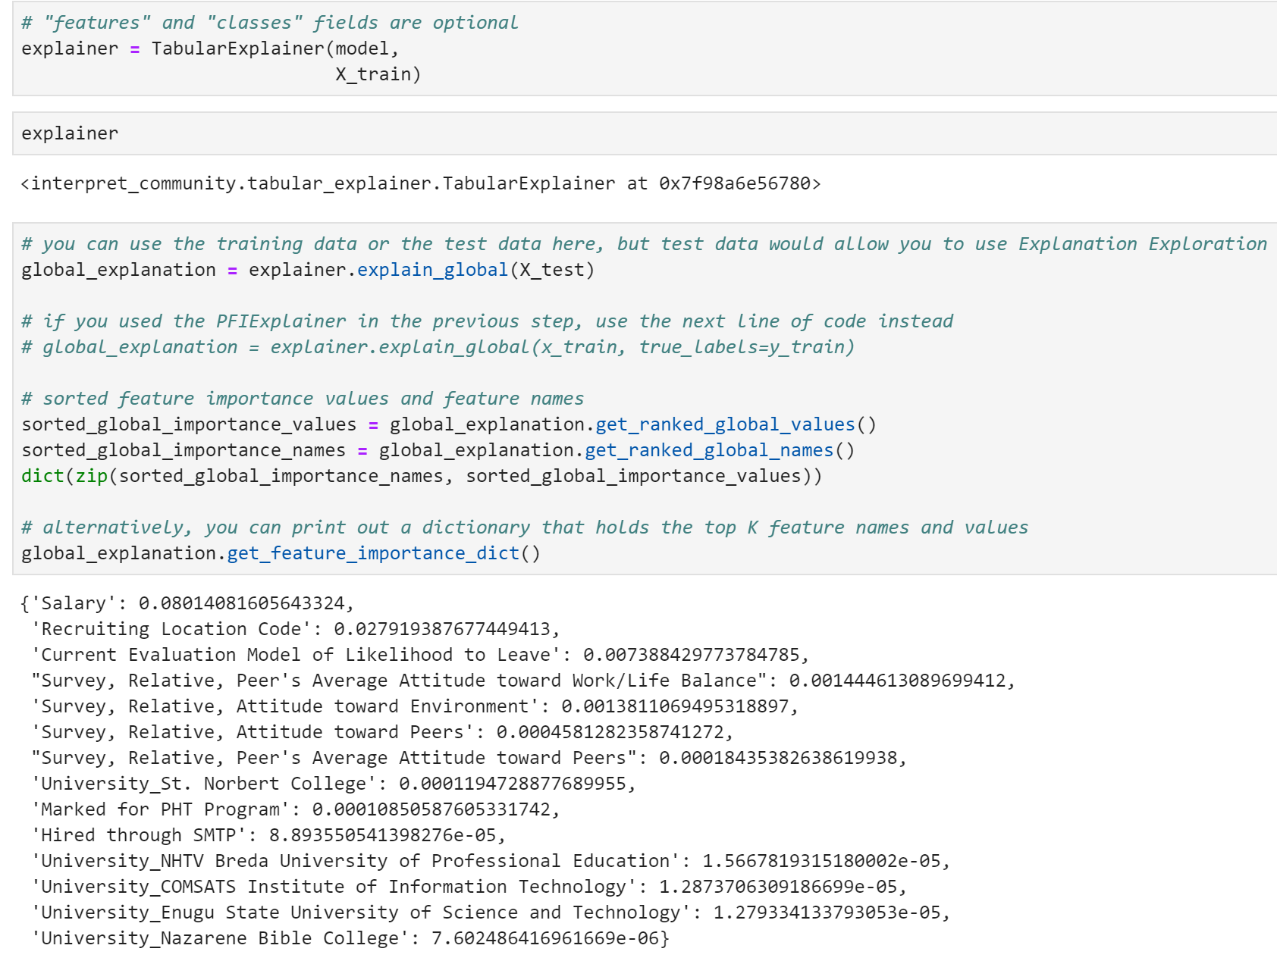
Explainability

Slide 13
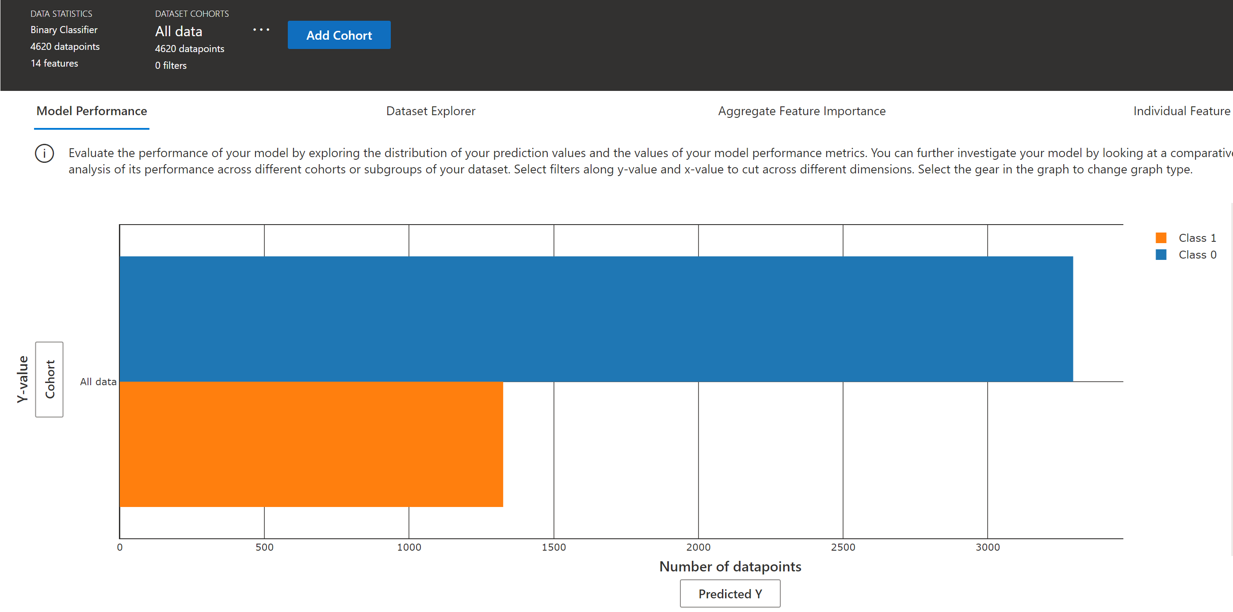
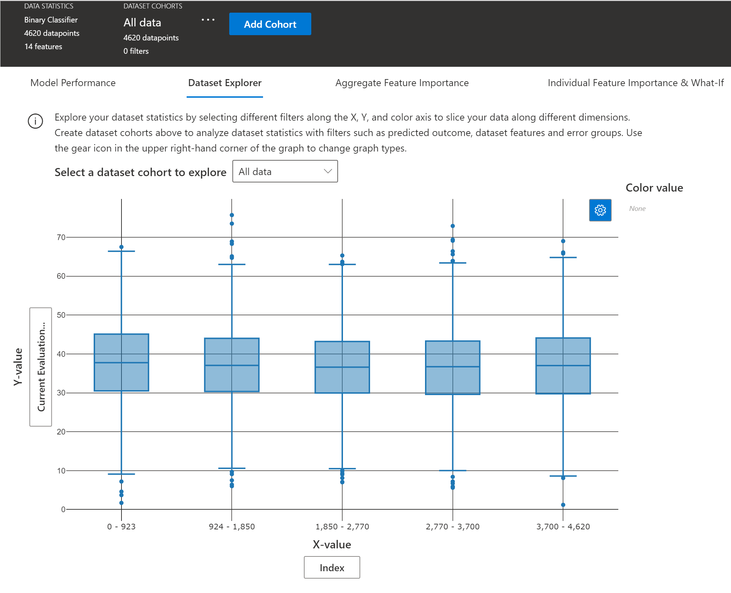
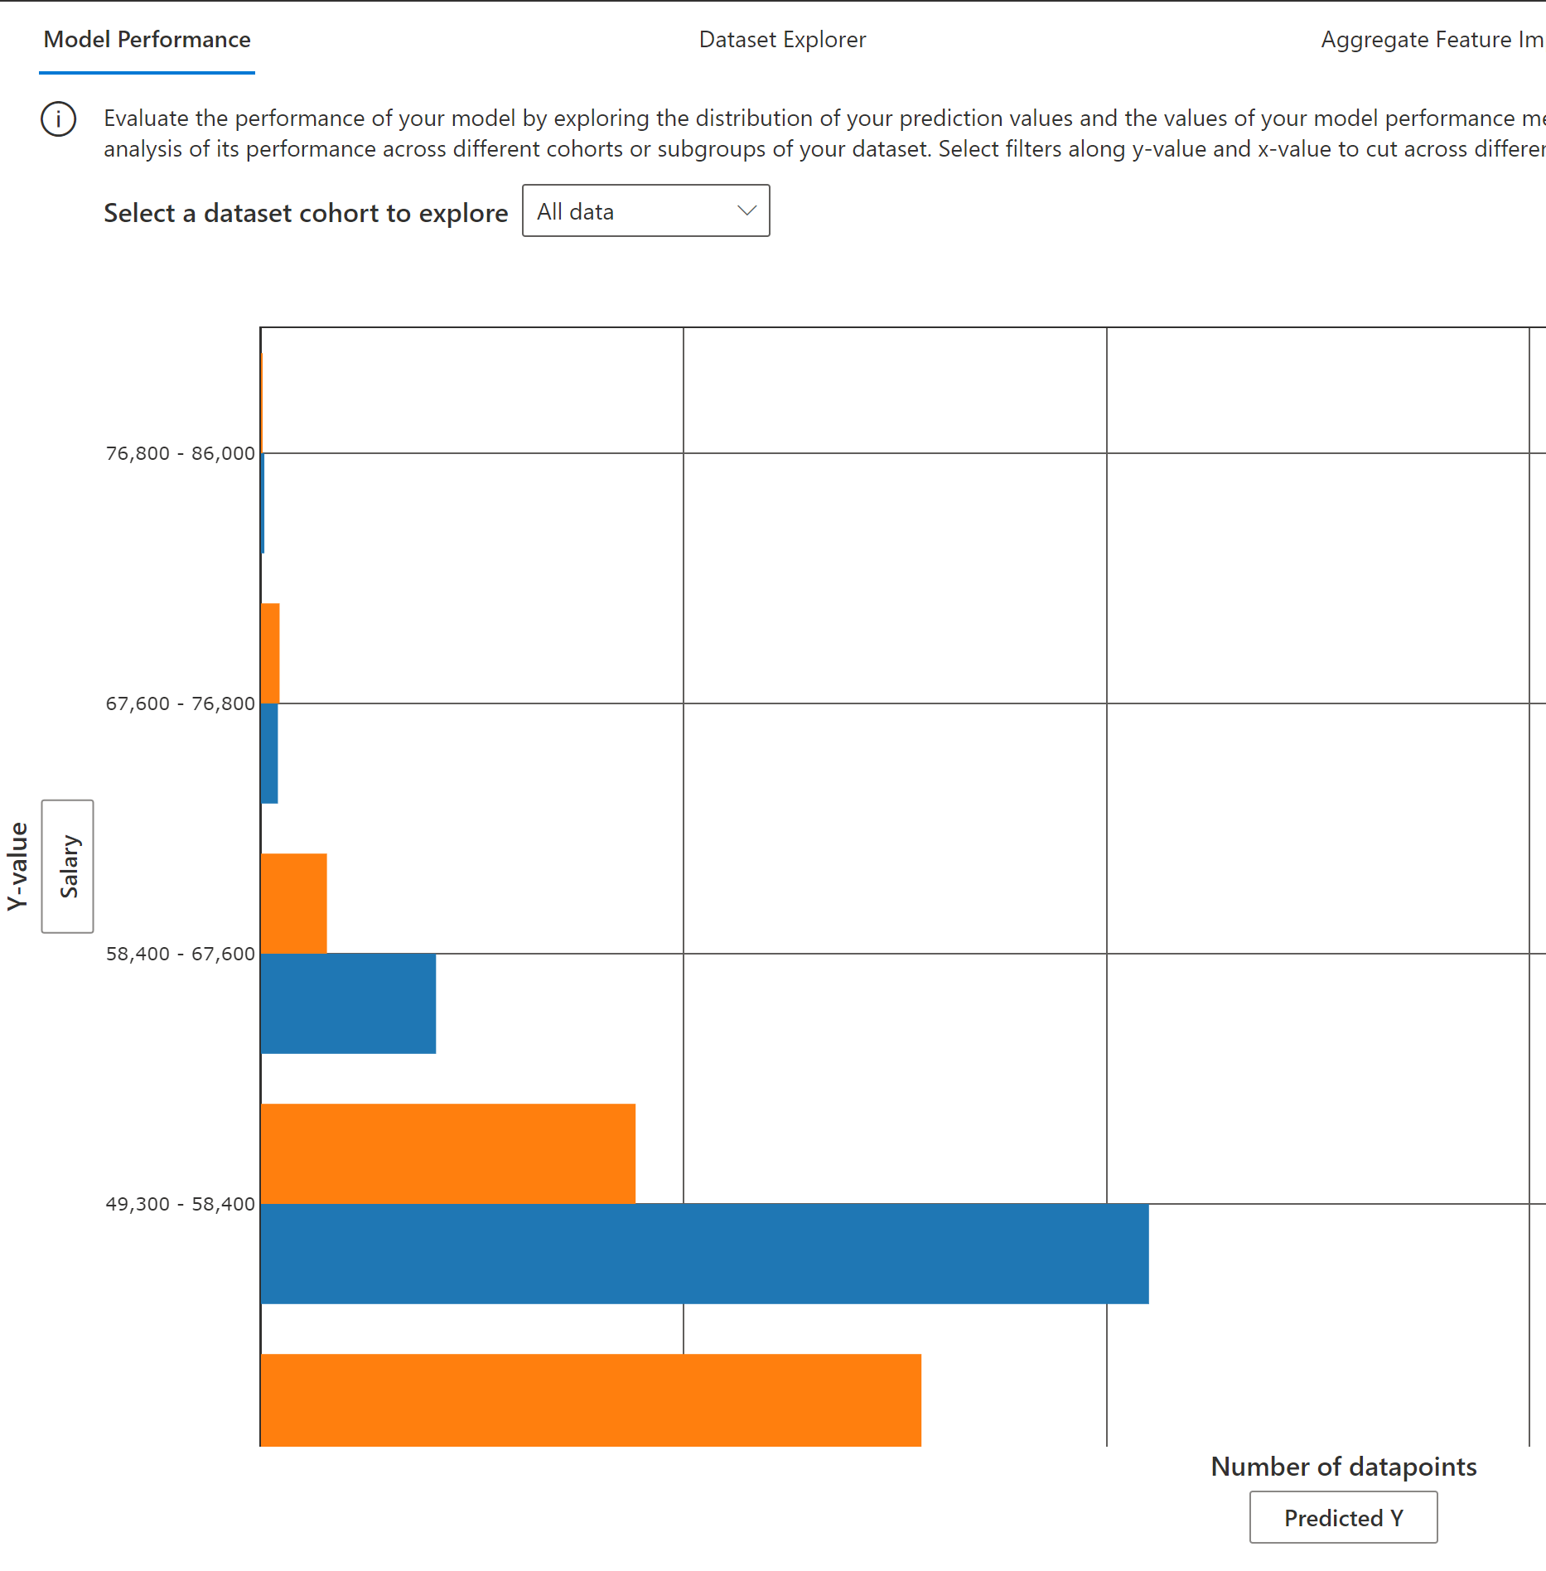
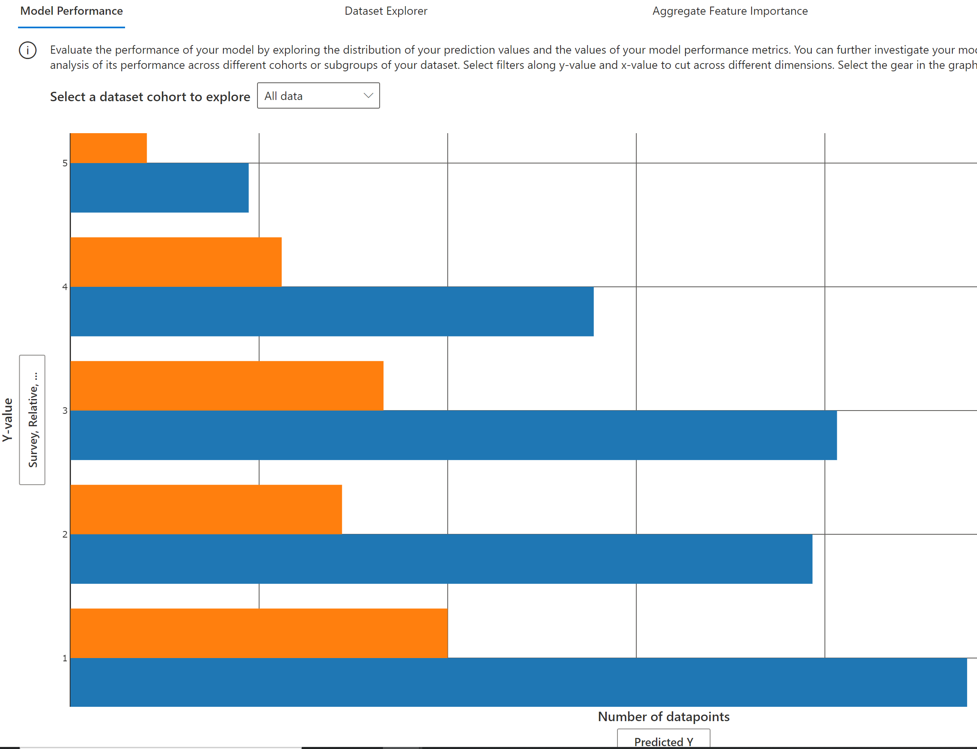
Model Performance

Slide 14
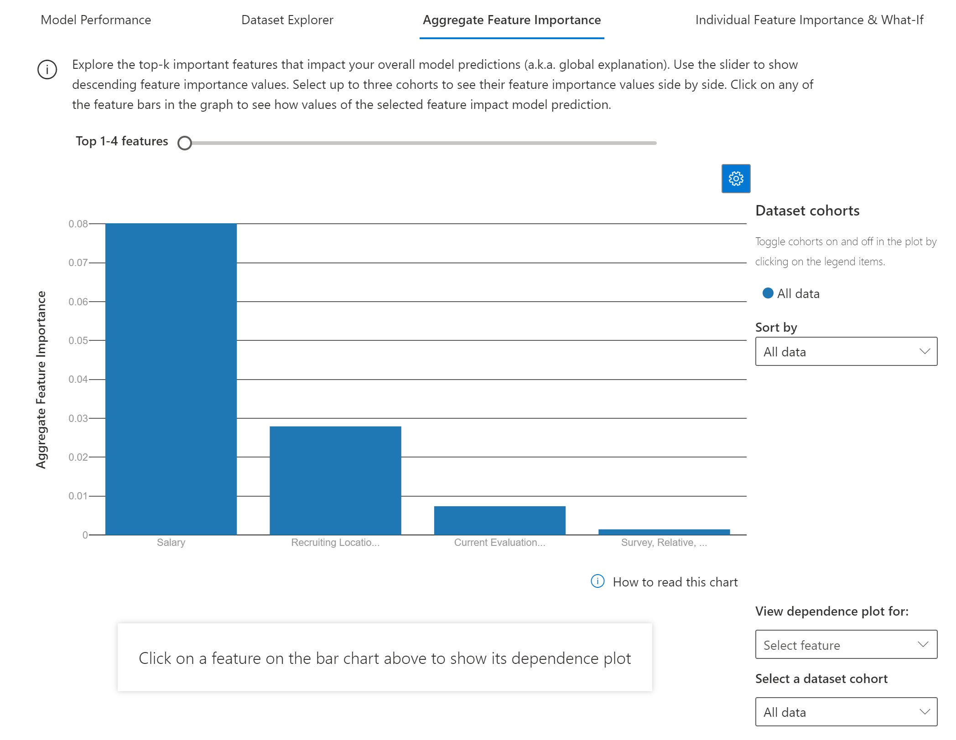
Aggregate Feature Importance

Slide 15
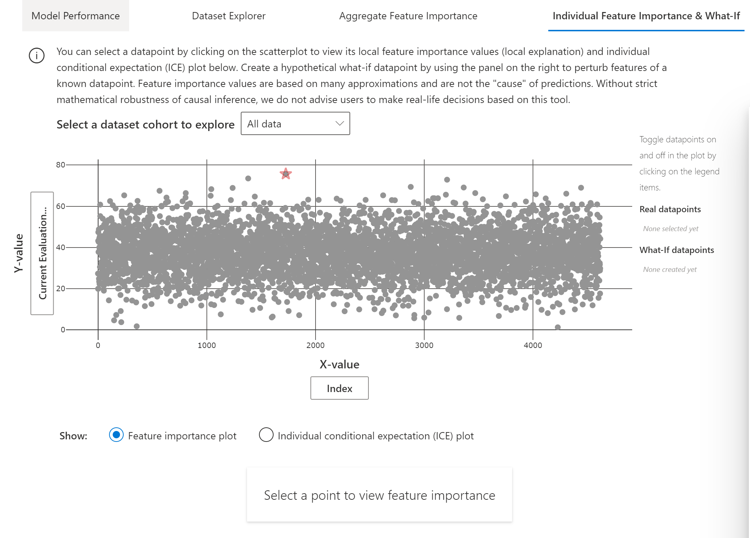
Feature Importance - Individual

Slide 16
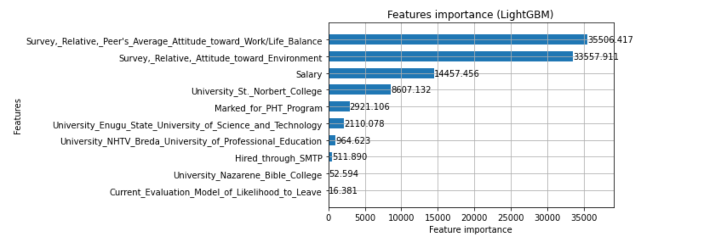
LightGBM features importance

Slide 17
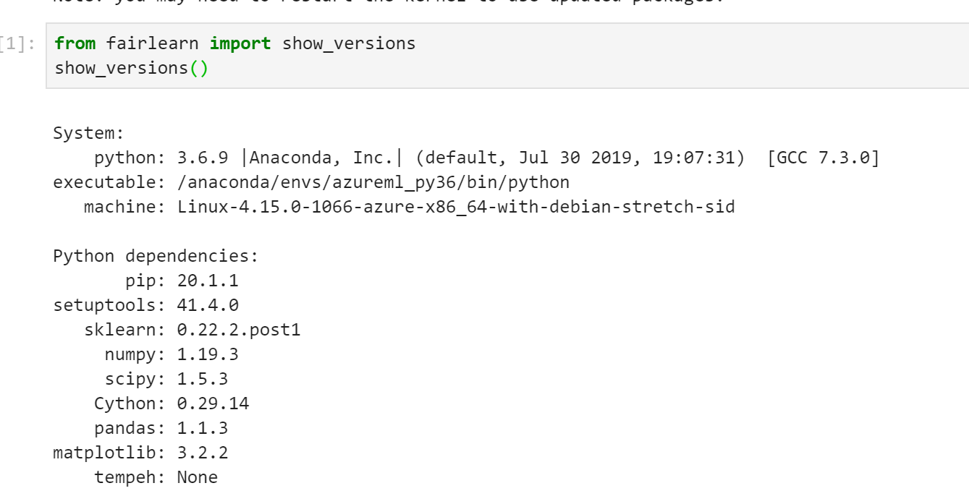
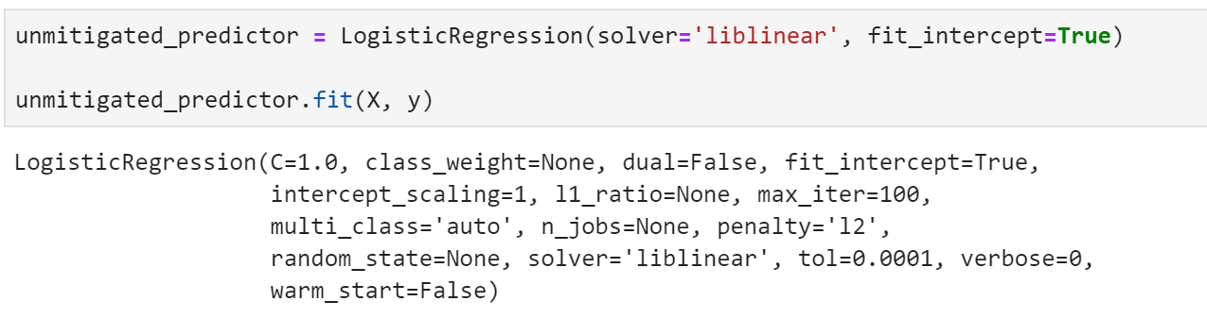
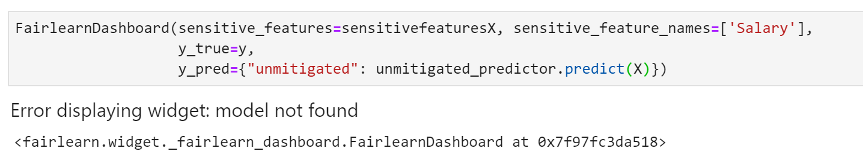
Fairness using Fair Learn

Slide 18
Outcomes
Modelling Accuracy
Explainability: Please prepare to explain local feature effects for every observation of the holdout dataset.
What features affect the model, particularly how much relevance it had for the prediction
Bias: It is of critical importance that this model does not bias against any protected classes. Please ensure that the outcome of this model does not result in any such bias. No bias beyond 5% outcome disparity is acceptable in any protected class.
How did the Bias affect the model
Employee left is the label that is predicted. 0 = Employee not leaving, 1 = employee left
0 = 7854
1 = 6146

Slide 19
Architecture

Slide 20
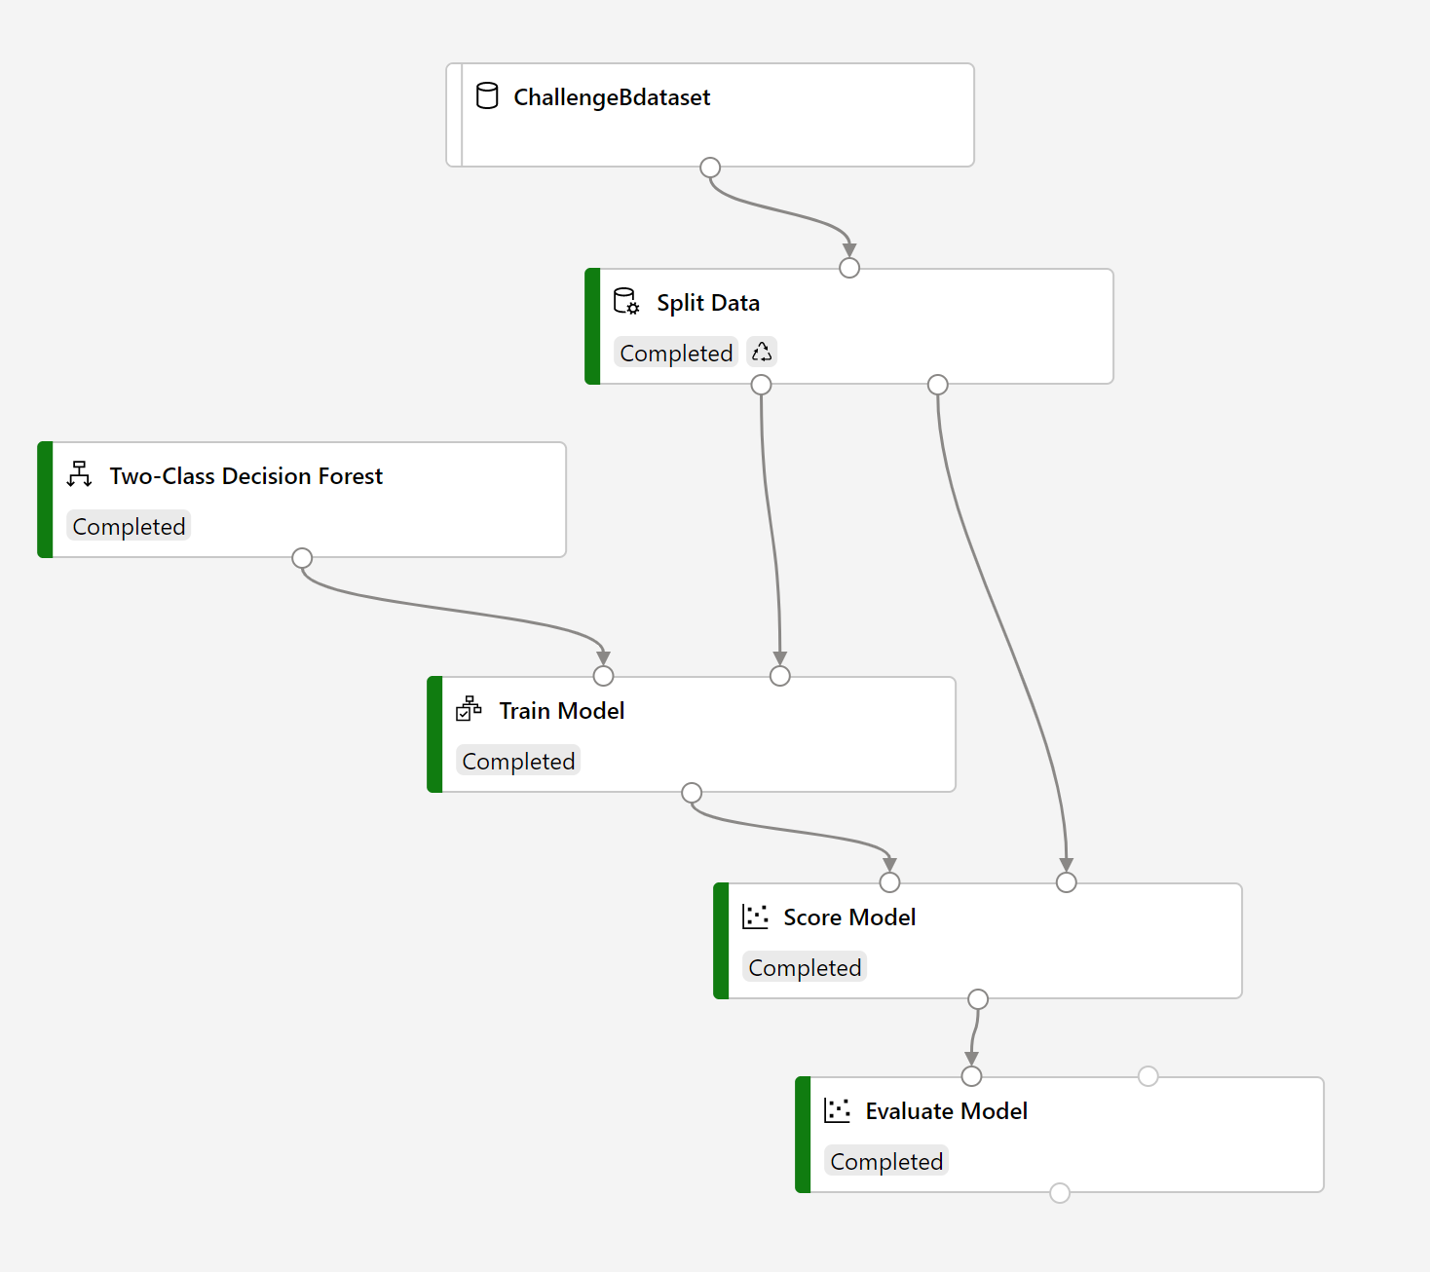
Designer

Slide 21
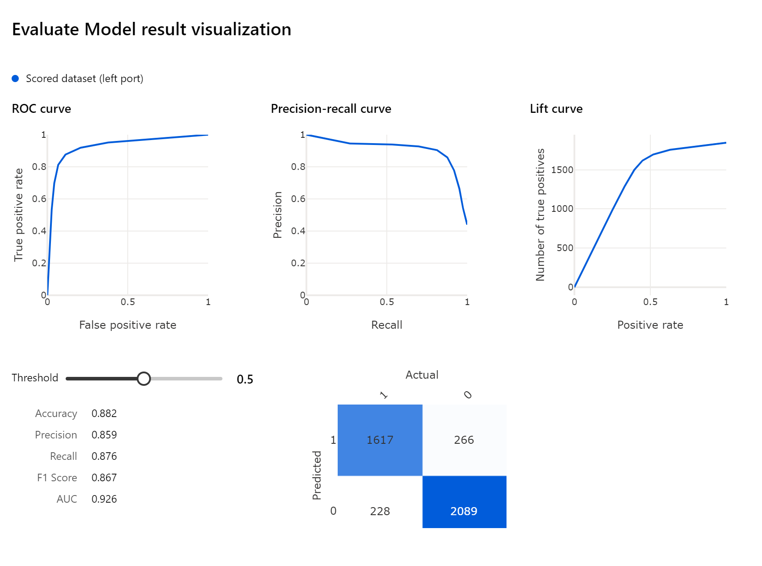
Output Metrics
ROC Curve is pretty good closer to 1
Confusion matric show the precision and recall

Slide 22
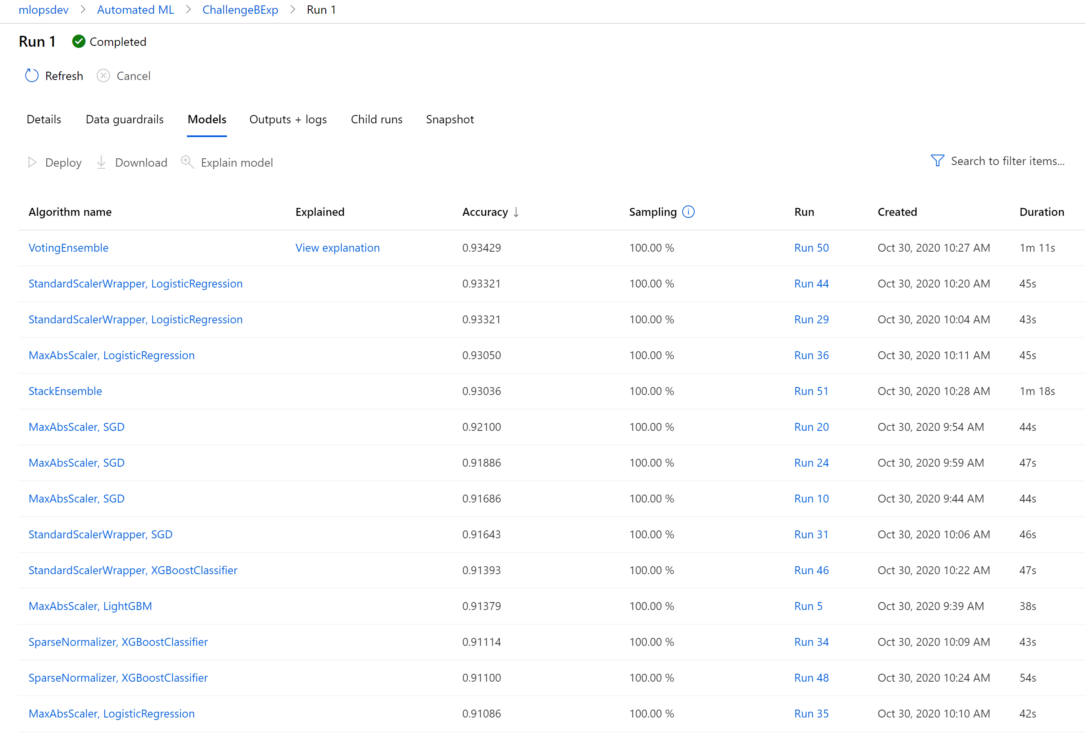
Automated ML

Slide 23
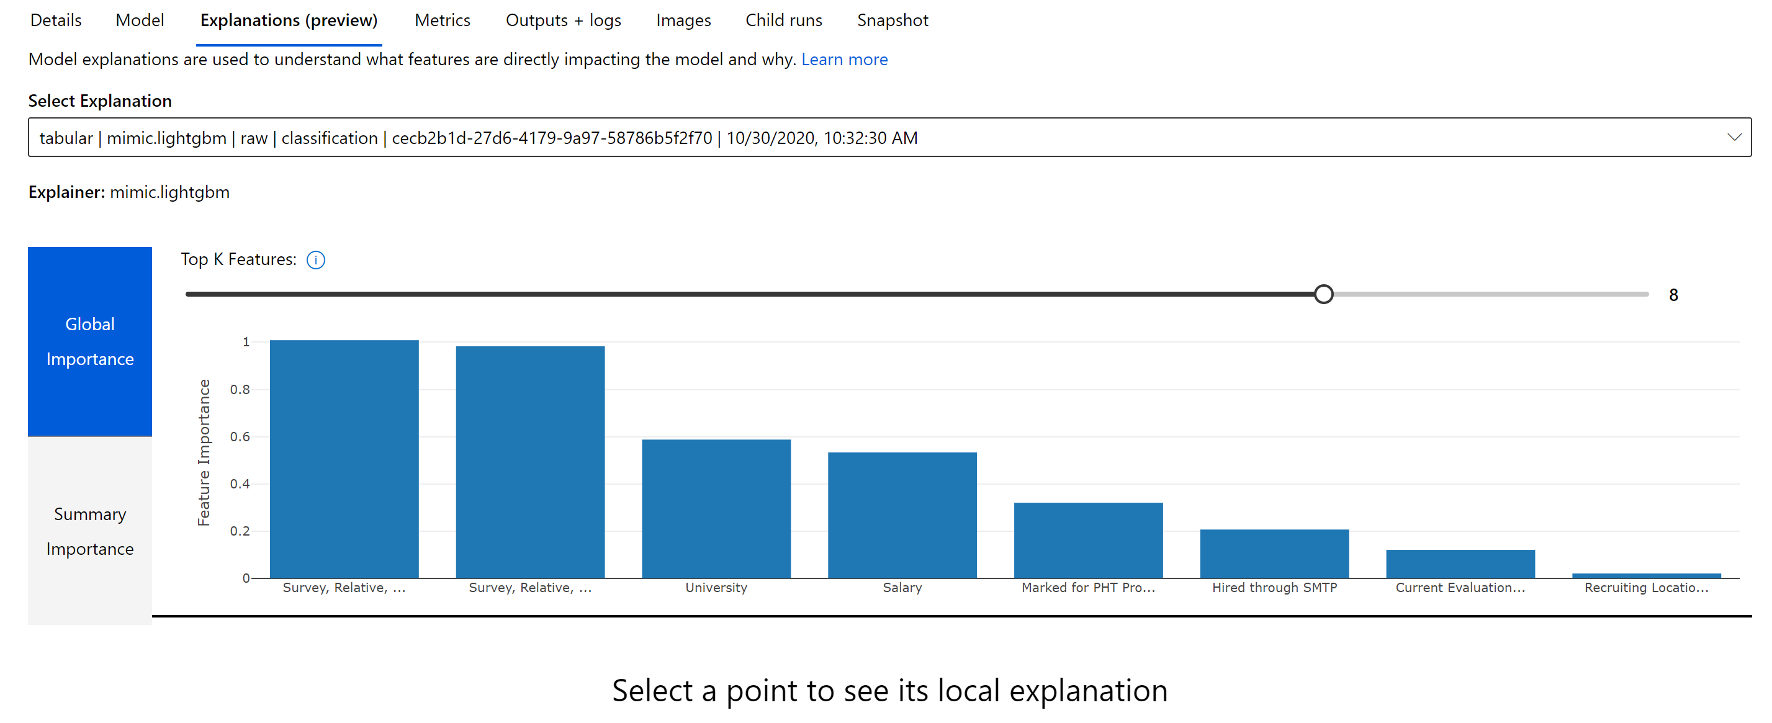
Explain ability – Global Importance

Slide 24
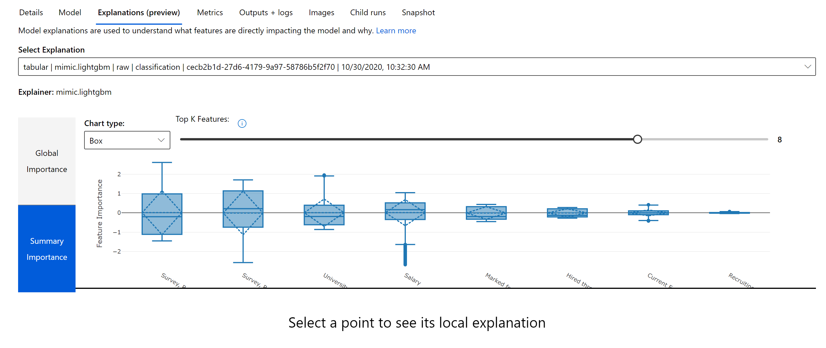
Summary Importance

Slide 25
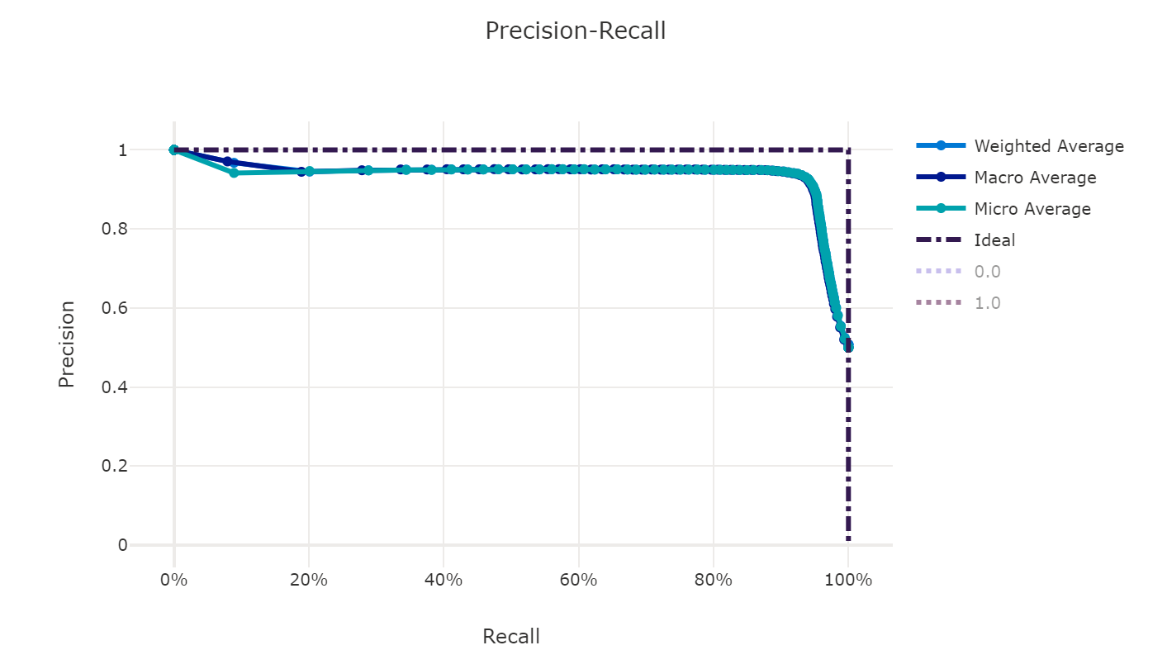
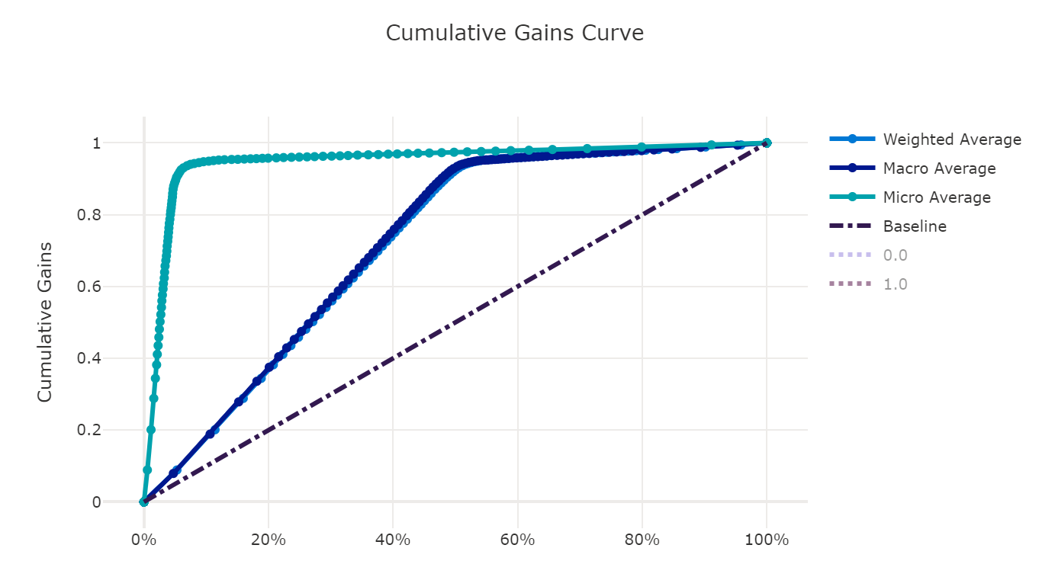
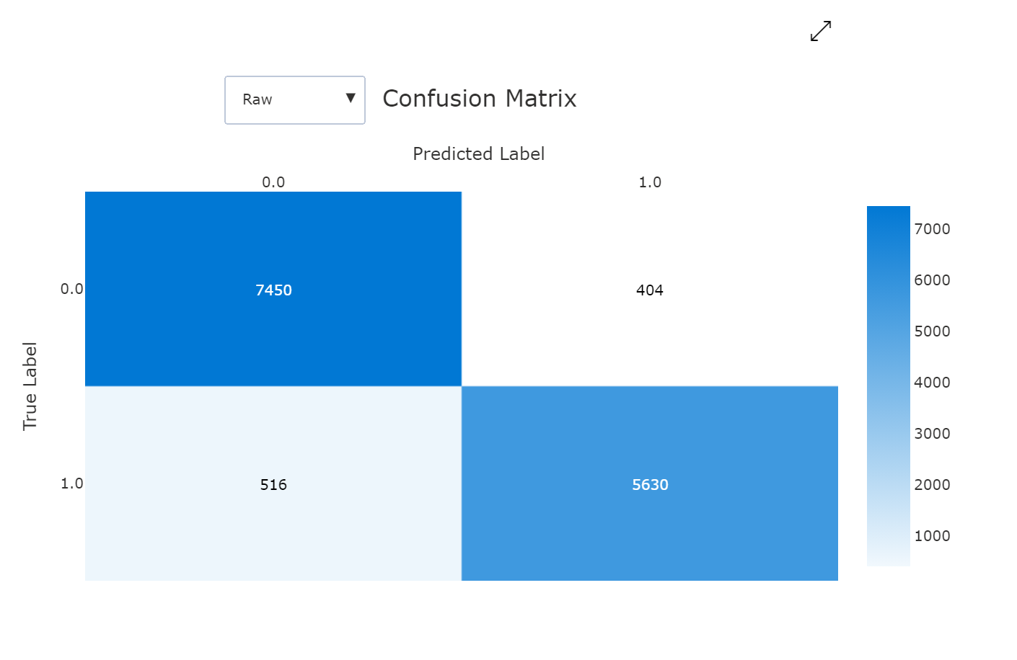
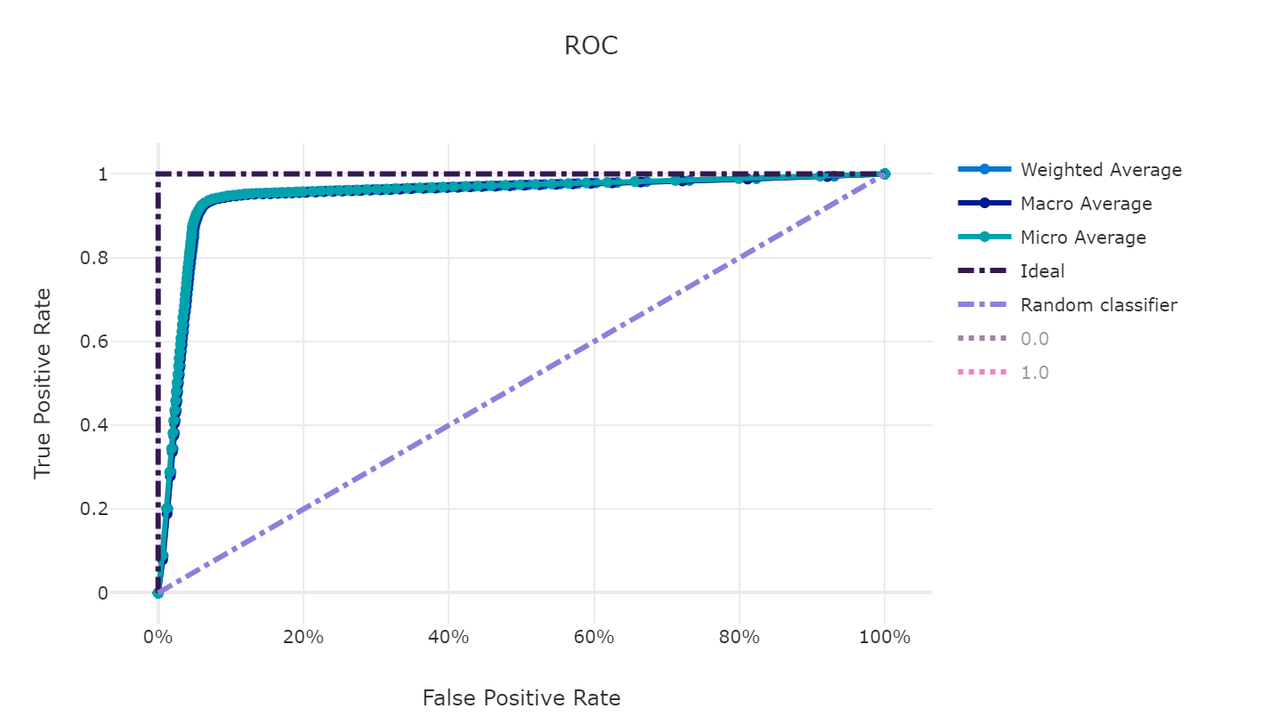
Metrics
Roc Slope is close to better prediction
Closer to 100%, more accurate the model is
Precision Recall are pretty high, shows the model accuracy is pretty Good.

